Slide 1

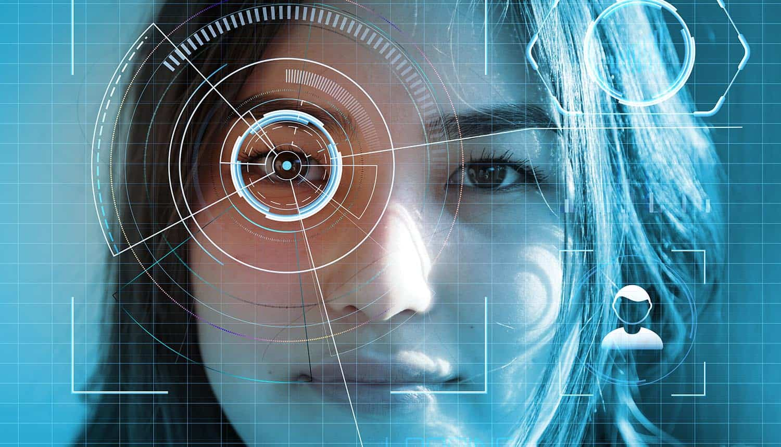
WEB-BASED SMART ATTENDANCE AND EMOTION TRACKING SYSTEM USING FACIAL RECOGNITION TECHNOLOGY
FINAL YEAR PROJECT
OPOLOT JUSTINE

Slide 2
INTRODUCTION
A smart attendance and emotion tracking system is a system that automates attendance and emotions tracking of employees or students in educational institutions or organizations using facial recognition technology in order to provide insights about wellbeing, and engagement in classrooms.
Facial Recognition technology is a biometric technology that uses machine learning algorithms to analyze and identify a person's facial features and emotion. It can also detect and recognize faces from digital images or video footage and compare them to a database of pre-registered faces.
In today's fast-paced world, managing attendance has become a critical task for organizations and educational institutions, as it helps to manage employee and student attendance, payroll management, resource allocation, and accountability.
This type of system can automate the attendance tracking process, provide valuable insights into employee and student engagement and well-being, and reduce errors and costs associated with traditional attendance tracking methods.

Slide 3
BACKGROUND
Attendance tracking is a crucial and daily task for organizations and educational institutions.
Traditional attendance tracking methods include; manual data entry, roll call for students as well as clock in and clock out times as well as paper sign- in sheets for employees.
Facial recognition technology has been around for decades and has become more accurate and efficient with recent advancements in machine learning algorithms.
Therefore, accurate and reliable attendance records are essential for organizations to make informed decisions about employee and student performance, resource allocation, and overall success.
Additionally, emotion tracking can be integrated in order to provide insights about employee or students’ engagement in the classroom or workplace and their generally wellbeing.

Slide 4
PROBLEM STATEMENT
Traditional attendance tracking methods can be time-consuming and prone to errors, leading to inaccurate attendance data and potentially costly mistakes.
Moreover, they do not provide valuable insights into employee and student engagement and well-being, which can impact overall productivity and performance.
This project aims to address these challenges by developing a web-based smart attendance tracking system that uses facial recognition technology to automate the attendance tracking process, provide accurate attendance data, and improve engagement and well-being through the integration of emotion detection technology concept.

Slide 5
PROJECT JUSTIFICATION
The proposed system will provide a fast, accurate, and reliable attendance tracking solution for organizations and educational institutions. By using facial recognition technology, the system will automate the attendance tracking process, reduce errors and costs associated with traditional attendance tracking methods, and improve overall efficiency.
Moreover, by using emotion recognition technology, the system will provide valuable insights into employee and student engagement and well-being, which can help organizations and educational institutions to improve employee and student satisfaction, productivity, and overall success.

Slide 6
OBJECTIVES
Main Objective:
To develop an effective system which can automate the attendance tracking process and provides valuable insights into employee or student engagement and well-being based on their emotions.
Specific Objectives:
To develop a facial recognition algorithm that can accurately detect and identify faces from digital images or video footage.
To integrate the facial recognition algorithm with a web-based attendance tracking system that can automatically record attendance data.
To develop an emotion detection algorithm that can recognize and analyze the emotions of people based on their facial expressions.
To integrate the emotion detection algorithm with the web-based attendance tracking system to provide insights into employee/student engagement and well-being.
5.To develop a user-friendly interface that can be easily accessed and used by employers and educational institutions

Slide 7
RESEARCH QUESTIONS
How can a facial recognition algorithm be developed to accurately detect and identify faces from digital images or video footage?
What is the most effective way to integrate the facial recognition algorithm with a web-based attendance tracking system for automatic recording of attendance data?
which emotion detection algorithm can be used to recognize and analyze the emotions of people based on their facial expressions?
What is the best method to integrate the emotion detection algorithm with the web-based attendance tracking system for providing insights into employee/student engagement and well-being?
How to make a user-friendly interface easily accessed and used by employees, students, and other users?

Slide 8
SIGNIFICANCE OF THE STUDY
This project is significant as it provides an automated and accurate attendance tracking system that can save time and effort for organizations and educational institutions.
Additionally, the integration of emotion detection technology can provide valuable insights into employee and student engagement and well-being, which can help in decision-making processes and overall organizational development.

Slide 9
SCOPE OF THE STUDY
The scope of this project includes the development of a facial recognition algorithm and emotion detection algorithm, integration with a web-based attendance tracking system, and the development of a user-friendly interface. The system will be tested and validated on a sample of users to ensure accuracy and reliability. The initial focus will be on use cases in educational institutions and organizations, but the system can be adapted to other contexts as well.
In the future, the system may be expanded to include additional features, such as real-time monitoring and analysis of attendance and engagement data, integration with other HR or educational management systems, and the development of personalized dashboards and reports for individual users.

Slide 10
DEMO

